Slide 1
Spine Type Analysis
Manual data collection, automatical data analysis

Slide 2
ImageJ Analysis of spine characteristics
Use the Analysis_SpineType_Tool_v001.ijm to obtain spine characterisitcs
Use the segmented line tool of ImageJ to mark first the width of the spine and then the length (this order is very important!!), use the short cut strg + t to add the marked width and length of the spine to the ROI manager. Continue with this until all spines of the given dendrite is marked. Lastly, add the the ROI of the dendrite you analyzed.
Note I: You an check if you missed something with when you check the „show all“ button in the ROI Manager
Note II: It is very important to follower the order 1. width, 2nd length and that nothing else (despite of the dendrite length) is in the ROI Manager
When the marking of the spines is finished, press the ok button. You will get the following:
.zip file containing all your marked spines
.csv file containing all measurments of spine width and length

Slide 3
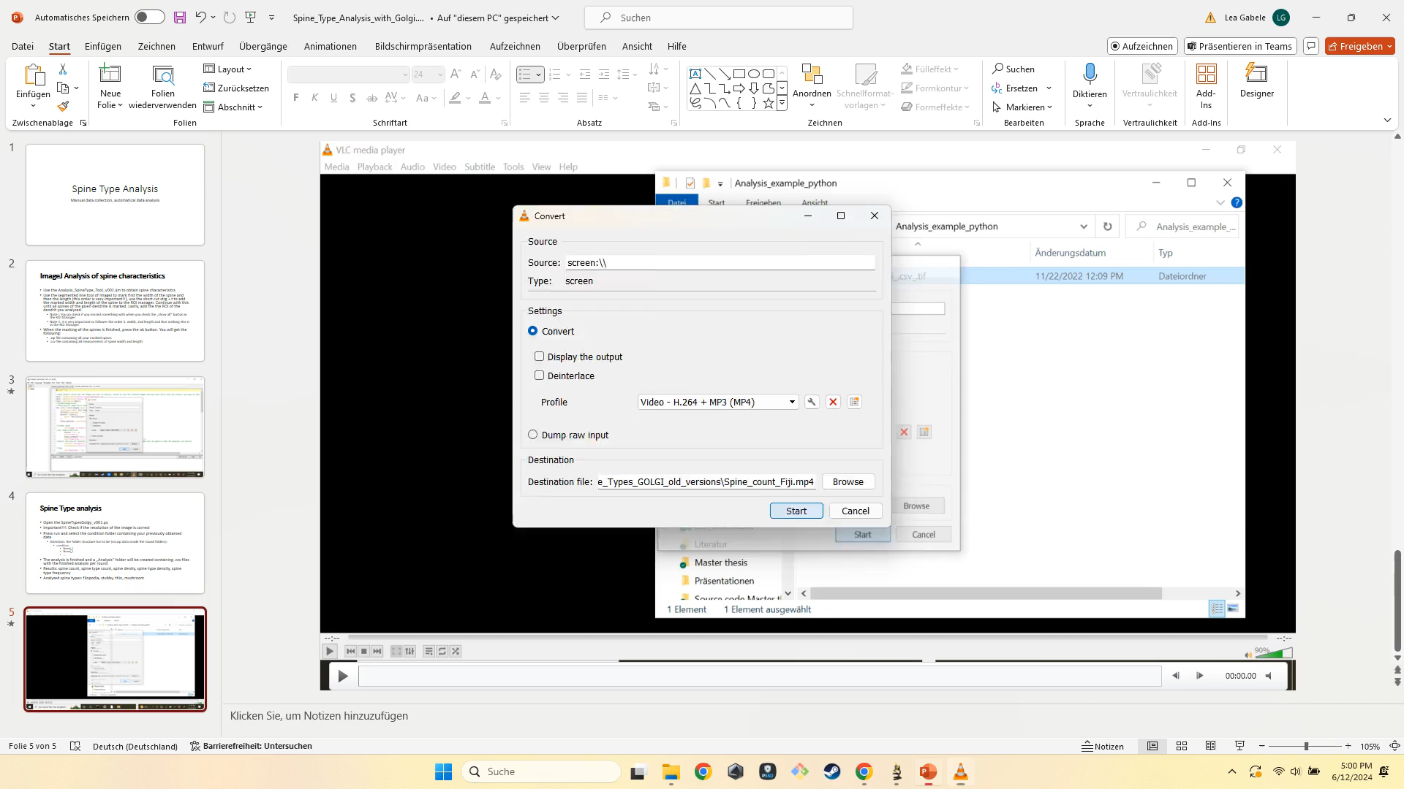

Slide 4
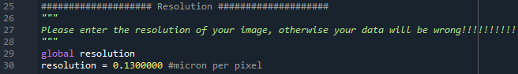
Spine Type analysis Python
Open the SpineTypesGolgy_v001.py
Important!!!: Check if the resolution of the image is correct
Press run and select the condition folder containing your previously obtained data
Attention: the folder structure has to be (roi.zip data inside the round folders):
condition
Round_1
Round_2
…

Slide 5
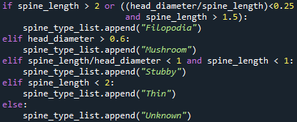
Spine Type analysis Python
The analysis is finished and a „Analysis“ folder will be created containing .csv files with the finished analysis per round
Results: spine count, spine type count, spine dentiy, spine type density, spine type frequency
Analyzed spine types: filopodia, stubby, thin, mushroom

Slide 6
